Slide 1
ITBW41 Predictive Analytics Presentation
By
Parik, Jia Jun

Slide 2
Content:
Overview of the objective of our models
Data understanding and preparation
Our modelling processing and explanation of the results
How we compare the models
Demo

Slide 3
Overview of our objective of our models
JJ
Our objective is to help venture capitals predict the success of a startup company better using machine learning algorithms to create models that predict the outcomes of a startup on whether it will be successful or a failure. There are several algorithms to choose from and our goal is to make the most accurate result possible using Random Forest, Decision Tree, Support-Vector Machine (SVM) and Logistic Regression to provide our forecast result on whether the startup will turn into a success or a failure.

Slide 4
Data Understanding & Preparation
Data Visualisation
Check for missing data
Replacing missing data with KNN value
Implementing new columns
Removal of rows and columns
Removing outliers
Feature Selection

Slide 5
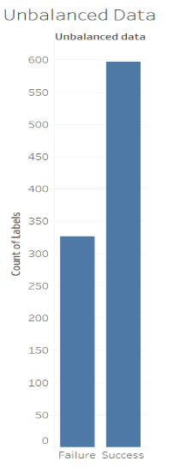
Balance of Data
The data is balanced at the ratio of 65/35 ratio.
With imbalanced data, it doesn't represent the true distribution of the data.With unbalanced data our accuracy will be very high. To keep our classifier honest, it was important for me to check about the data balance.

Slide 6
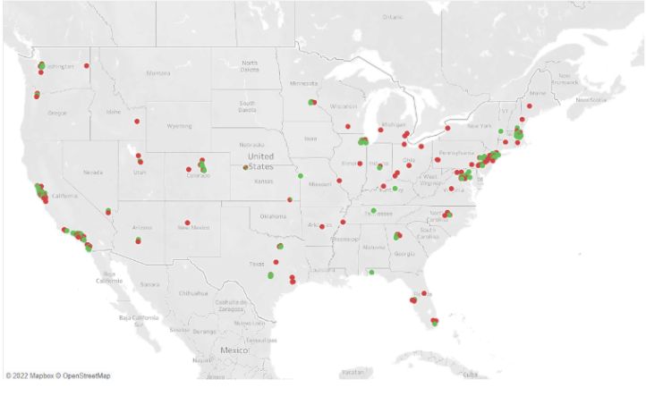
Map Analysis
I used the map chart to show which state produces the most success and most failure companies. By doing this, we are able to analyse whether if the state is a factor for the company’s success or not.

Slide 7
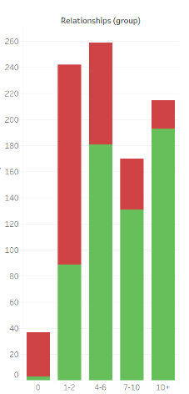
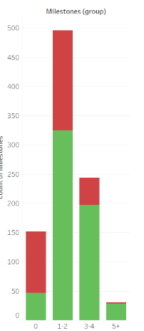
the correlation between the feature to its success/failure.
The correlation of the number of relationships
Statistics:
77.0 % of the startups are successful if they have relationships in the range of 7-10.
89.8 % of the startups are successful if they have more than 10 relationships.
Conclusion:
Companies with more Relationships are more likely to succeed as compared to companies with fewer Relationships.
the correlation of the number of milestones
Statistics:
65.5 % of the startups are successful if their milestone range from 1-2.
80.7 % of the startups are successful if their milestone range from 3-4.
companies with more number milestones are more likely to succeed as compared to companies with fewer milestones.

Slide 8
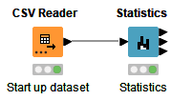
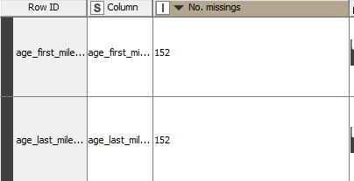
Checking on Missing values
Jia Jun
We used Knime to find out the statistics of the data, by using a csv reader node to read our dataset and then connecting it to a statistic node to find out the statistics of our dataset.
There are 2 columns that have a missing value
age_first_milestone_year
age_last_milestone_year

Slide 9
Impute the Missing values
Why KNN?
maintains the value and variability of your datasets and yet it is more precise and efficient than using the average values.
Why k = 5 ?
Since my data is not very big and only contains more than 933 rows I tried to keep my k value low.
Why we didn't use other ways to impute?
We did not replace the missing values with mean, median or mode values because using these methods to input can waste valuable data or lessen the variability of your data.

Slide 10
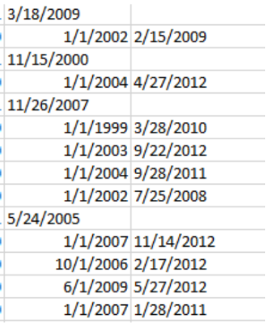
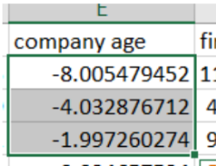
Implementing new columns
A date-time contains a lot of information that can be difficult for a model to take advantage of in its native form.
Removal of Errors
Delete 3 rows because the company's age is negative. By removing errors, we are inputting the correct values and the model will train correctly and better.

Slide 11
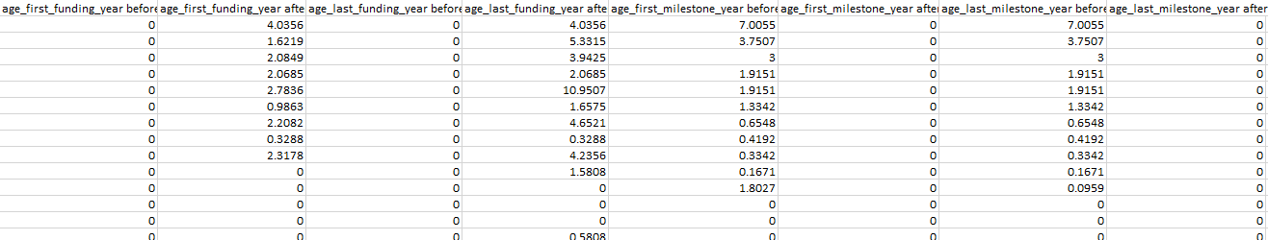
Transformation of columns
There were negative values in these 4 columns. This means that these companies were first funded and last funded before their company started - pre funding.
To transform this data, I made 8 columns. 2 of each feature.
Why did we transform the columns?
As some of the data included in some columns might be confusing to the machine, such as a negative value in the age_first_funding_year which represents the company has gotten it’s funding before they started. Since this might confuse the machine learning algorithm, therefore we created new columns to represent the such values.

Slide 12
Removal of Rows and Columns
JJ
We decided to removed 20 columns and 10 rows of outliers.
The 20 columns that were removed are
Unamed : 0
Id
Object_id
Latitude
Longitude
Zip_code
Unamed: 6
State_code
State_code.1
Status
Category_code
Founded_at
Closed_at
First_funding_at
Last_funding_at
Age_first_funding_year
Age_last_funding_year
Age_first_milestone_year
Age_last_milestone_year
Name

Slide 13

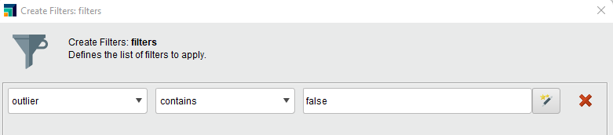
Removal of Outliers
Steps we took to check for outliers
We use Rapidminer to check for outliers, by using a Read Excel node to read our dataset then using a outlier Detect Outlier (Distance) node to detect the outliers. What is Detect Outlier (Distance)? It is the simplest outlier detection operator. It works by calculating the distance to the k- nearest neighbours of each example.
How do we deal with outliers?
We chose to only remove 10 rows of outliers as we only have 924 rows of data in total which is quite a small dataset.
We used Filter Examples node to filter out the outliers and only show the results of outliers is equal to ‘false’. Then use the Write Excel node to create an excel file to our local repository.
Problems faced
Having a very small dataset, we had to be very careful removing any rows.
The total rows we had was 924 rows of data, which is very little. Therefore we cannot remove a significant amount of rows when we clean the data as it might affects our analysis.

Slide 14
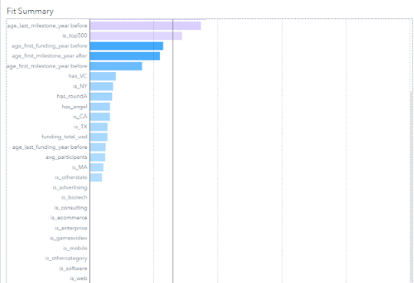
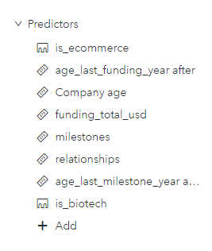
Feature Selection
Using some of the features might even make the predictions worse.
Thus, by using backward selection and setting our significance level to 0.05. 28 features that are removed by SAS viya.
We have 9 features left now.
Conclusion:
Adjusted R square improved from 0.8673 to 0.8695.

Slide 15
Modelling Process
Support Vector Machine
Decision Tree
Logistic Regression
Random Forest

Slide 16
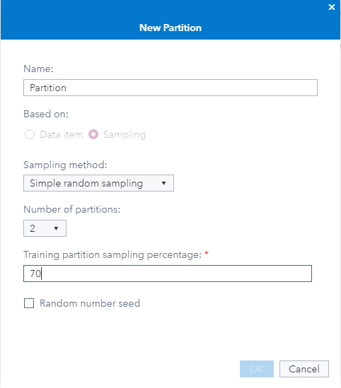
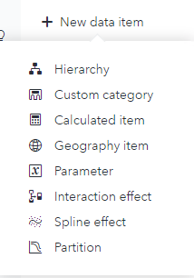
Partitioning
Partitioning is needed to partition the dataset to training and testing to detect the machine learning model behavior. It is necessary because if observations used in the training process are used, the evaluation of the model would be biased.
We partition our dataset in SAS Viya by adding new data item then put 70% of the dataset to training as our dataset is small.

Slide 17
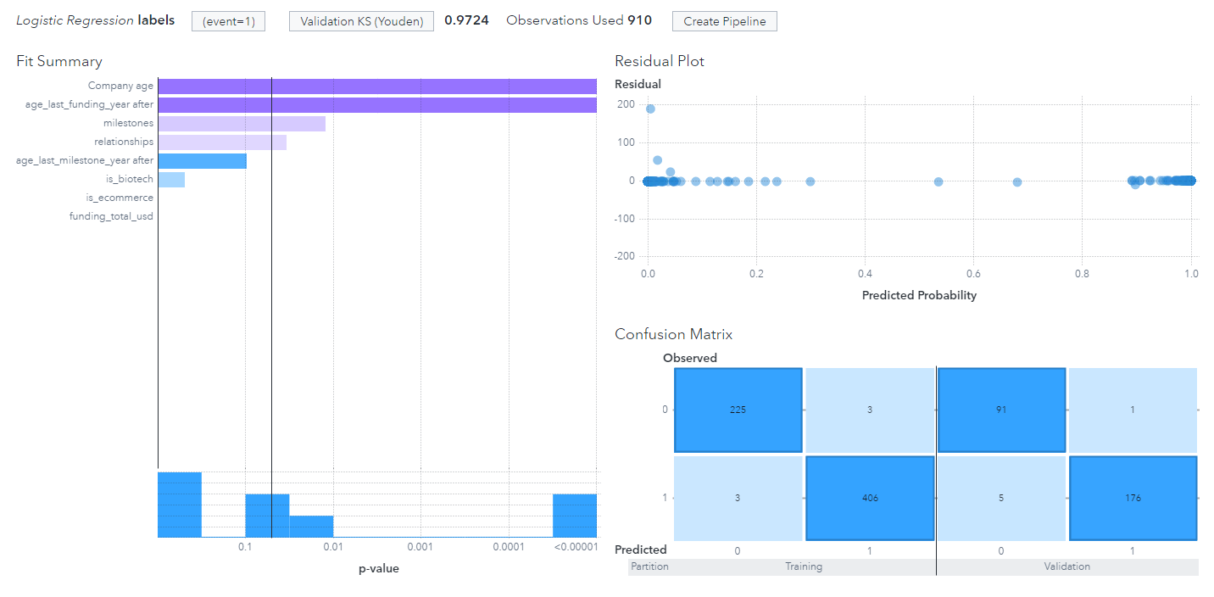
Logistic Regression
Maximum iterations: 50
Number of bins: 20
KS Youden: 0.9724
Misclassification rate: 0.0220

Slide 18
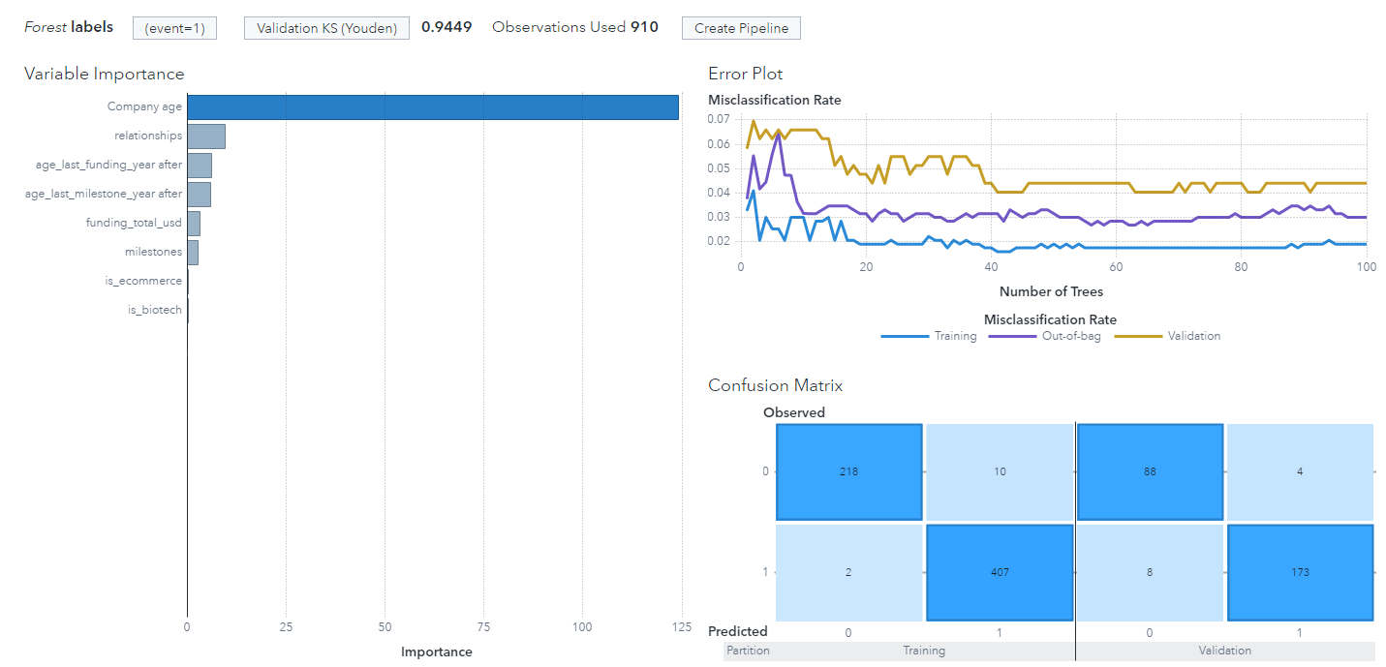
Before tuning Random Forest
Number of Trees: 100
Bootstrap: 0.6
Validation KS(Youden) : 0.9449
Misclassification Rate : 0.0440
Maximum Levels: 6
Leaf Size: 5
Predictor Bins: 50

Slide 19
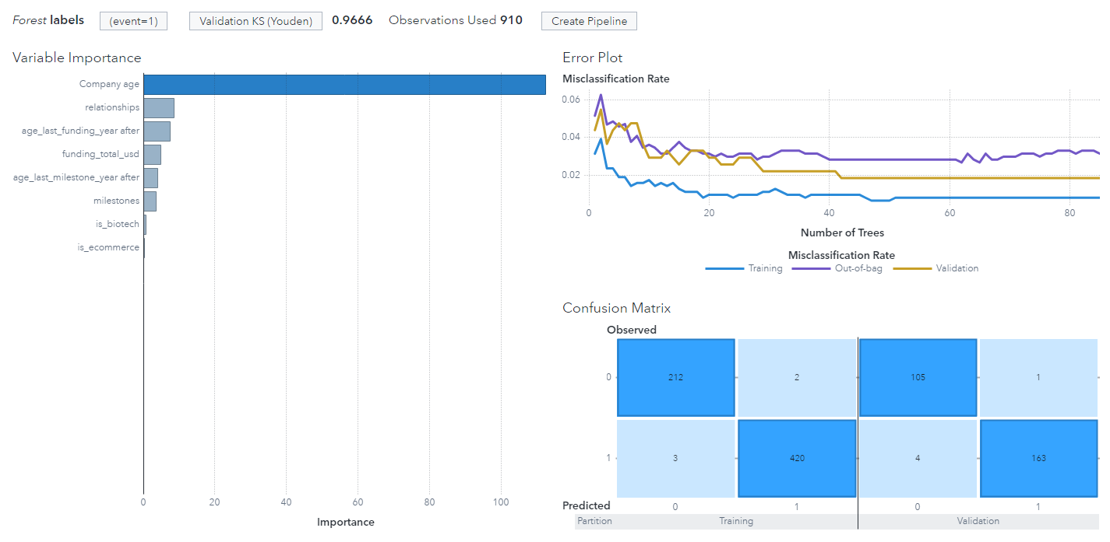
After tuning Random Forest
Random Forest
Number of Trees: Reduced from 100 to 85
Bootstrap: Reduced from 0.6 to 0.5
Validation KS(Youden) : Increased from 0.9449 to 0.9666
Misclassification Rate : Reduced from 0.0440 to 0.0183
Maximum Levels: Increasing the levels from 6 to 16
Leaf Size: Reduce the leaf size from 5 to 1
Predictor Bins: Reduce the bins from 50 to 40

Slide 20
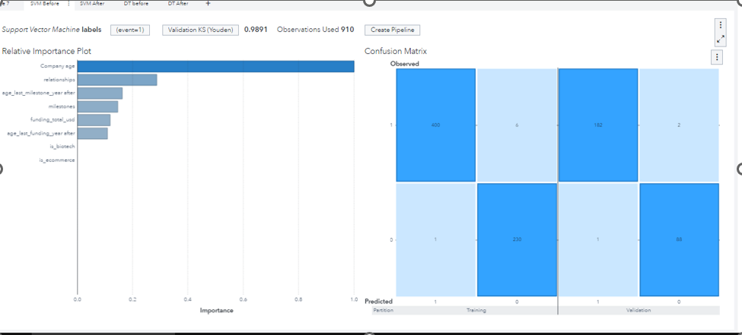
Support Vector Machine
Validation(KS Youden) : 0.9891
Misclassification Rate : 0.0110

Slide 21
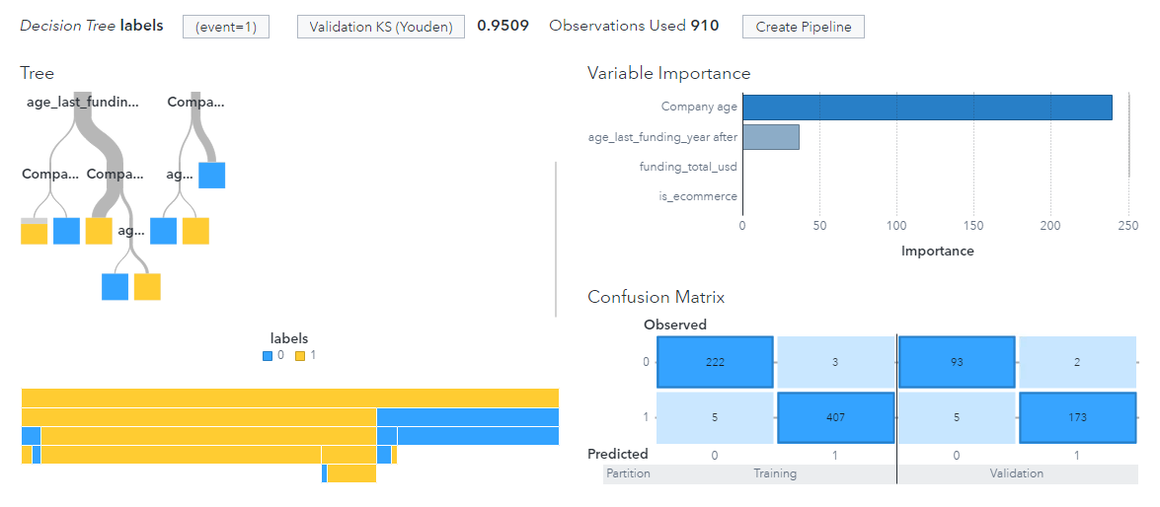
Decision Tree Before Tuning
Maximum Levels: 6
Leaf Size: 6
Predictor Bins: 50
Validation KS(Youden) : 0.9509
Misclassification Rate : 0.0330

Slide 22
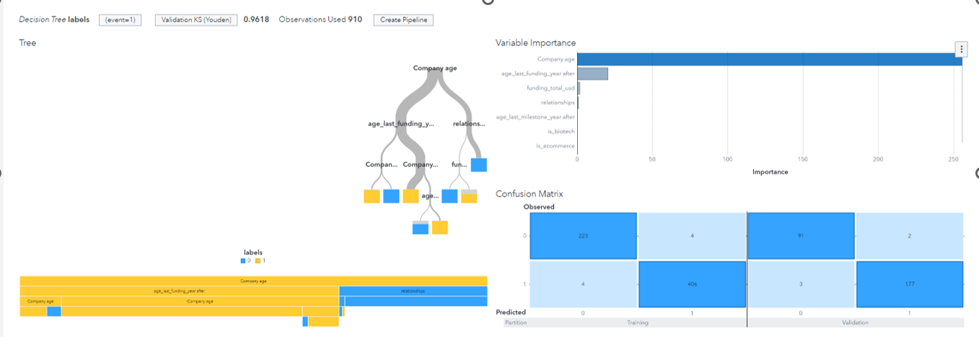
After tuning Decision Tree
Maximum Levels: Increasing the levels from 6 to 5
Leaf Size: Reduce the leaf size from 6 to 3.
Predictor Bins: Reduce the bins from 50 to 22.
Validation KS(Youden) : 0.9618
Misclassification Rate : 0.0275

Slide 23
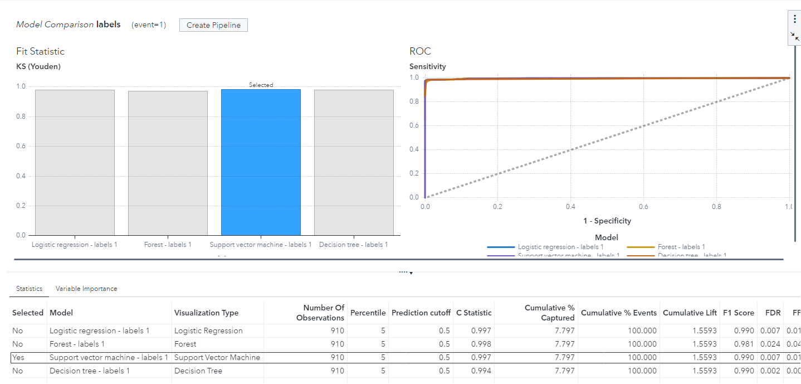
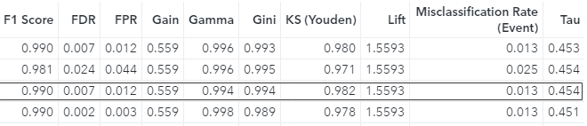
Model Comparison

Slide 24
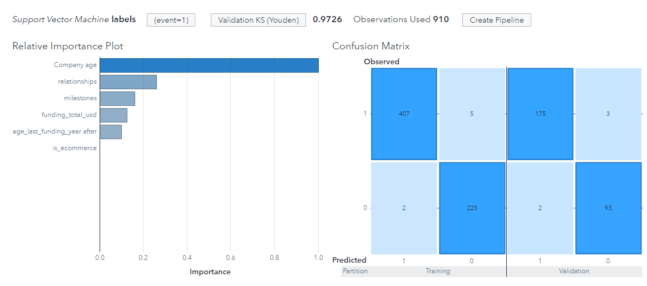
In Conclusion
Support Vector Machine is the best performing model as it gives the highest KS Youden.
Company age is the most important variable seen from the relative importance plot,
As seen from the confusion matrix, the number of predicted value that are predicted wrongly were very few, with 3 out of 178 True in Validation were predicted wrongly and 2 out of 95 False were predicted wrongly

Slide 25
